Slide 1
mdpetfinder.com
Software Engineer Team
Samuel Efesoa
Jacob Adelstein
Eddie Woods

Slide 2
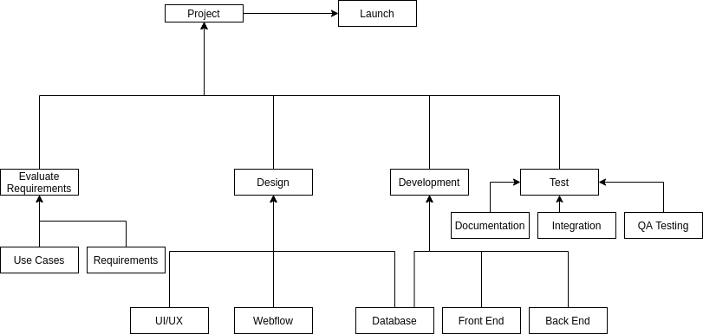
Work Breakdown Structure

Slide 3
Team Workload Breakdown
Eddie Woods
Database design
Front-end development
Technology research
Jacob Adelstein
Front-end development
Back-end development
Technology research
Samuel Efesoa
Front end development
Back-end development

Slide 4
Milestones
Analysis
06/29/21
Design
07/09/21
Develop
07/21/21
Final Q/A and Testing
07/22/21
Launch
07/26/21
Analysis
Completed on time
Design
Completed on 07/11/21
Lost in team members
Changed to buy route
Develop
Completed on time
Final Q/A and Testing
Completed throughout 07/22/21 to 07/26/21
Launch
Completed on time

Slide 5
Plugins
Display Posts
Display a listing of posts using the display-posts shortcode
Donorbox Donation Form
Donation payment portal via credit card or google pay
WooCommerce
eCommerce toolkit that helps sell anything
WPForm Lite
Contact form plugin

Slide 6
Requirements
Users should be able to search for pets
Search options
Type of pet
Location by zip code
User should be able to see a display of pets
Name
Age
Breed
Adoption Status
Health Records
Adoption Shelter
Admin should be able to update adoption status
Adoption facility should be able to create new listing for a pet
Website will accept donations
Website will display advertisements
Website will display information on proper care of pets

